Slide 1
REVISION
Example 1: “Describe a futuristic city with floating buildings.” [Microsoft Copilot]
EXAMPLE input :
  Generate a Futuristic Image of Nyeri town in a planet with Near-Zero gravity in the milky way galaxy the floating buildings will be a replica of Nyeri Town Buildings. With the People of Nyeri Flying in its street's. in the Morning vibrant rays closest star viewing the Great Black Hole.

Slide 2
REVISION
Example 2: “Write a poem about a lonely tree in autumn.” [ChatGPT]
  Example input:
    write for me a sad poem of the Avocado tree called ABOCADO that has just finished its cycle and cannot produce any more fruits for the season And the farmer is poor and relies on the tree the tree is Located in at the door step of the farmers House who leaves at the foot steps of the Great mount kenya.

Slide 3
Game Development with Generative AI
WEEK 2: Applying Generative AI to build simple game.

Slide 4
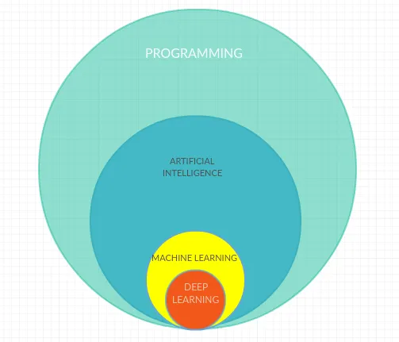
How Does Generative AI Work?
Generative AI uses machine learning models, especially deep learning, to learn patterns from a dataset and produce new data that mimics the original. These models include techniques like GPT (for text), GANs (for images), and VAEs (for complex structures).
GPT (Generative Pre-Trained Transformers)
GANs [generative adversarial network]
VAEs [variational autoencodes]

Slide 5
Real-Life Examples of Generative AI
Text Generation:
AI can write articles, stories, or poems based on given prompts (e.g., ChatGPT).
Image Creation:
AI can generate images based on text descriptions (e.g., DALL·E).
Music Composition:
AI can compose music by learning patterns from various genres.
Video Generation:
AI can create or enhance videos, even creating deepfakes.

Slide 6
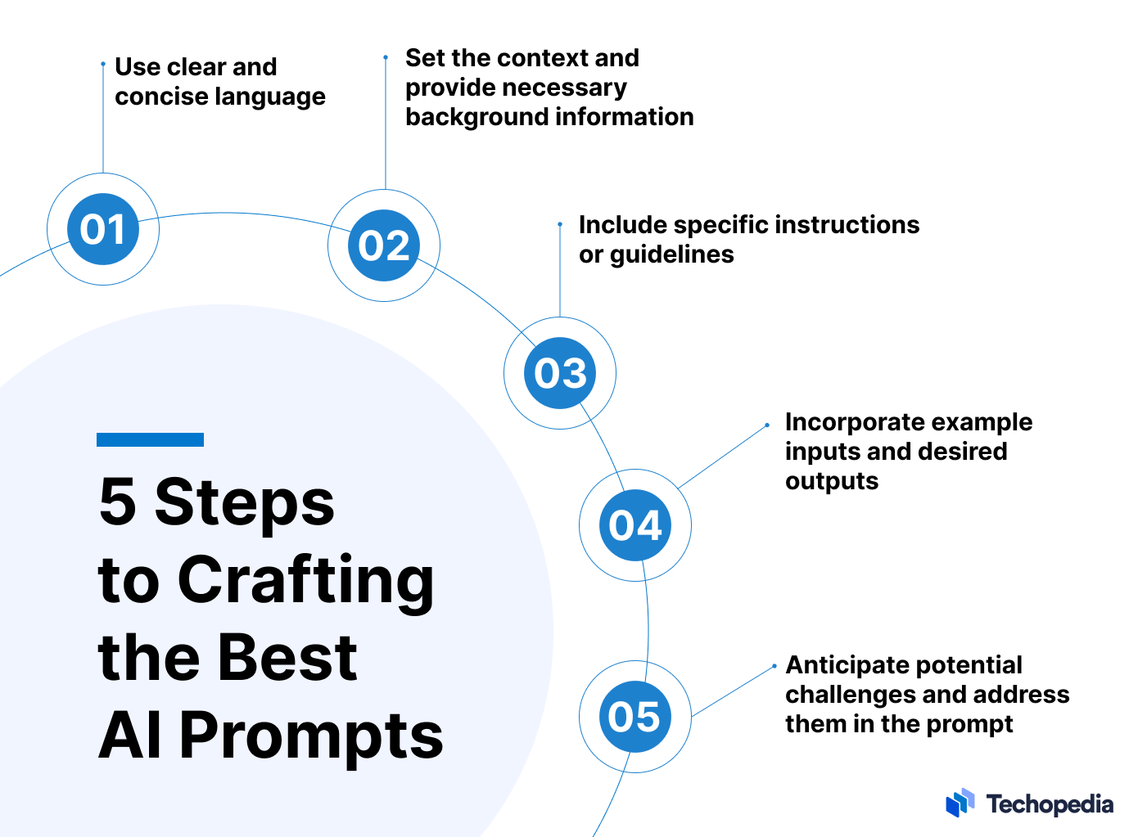
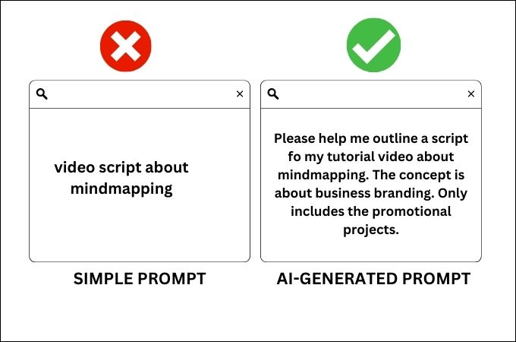
HOW TO STRUCTURE PROMTS
EXAMPLE:

Slide 7
Project: Flappy bird game
Create Prompts to Build the game with.
Create files to hold the code.
Copy and paste The code.
Test the Code if its working.
Re-promt the code to solve any Error in code

Slide 8
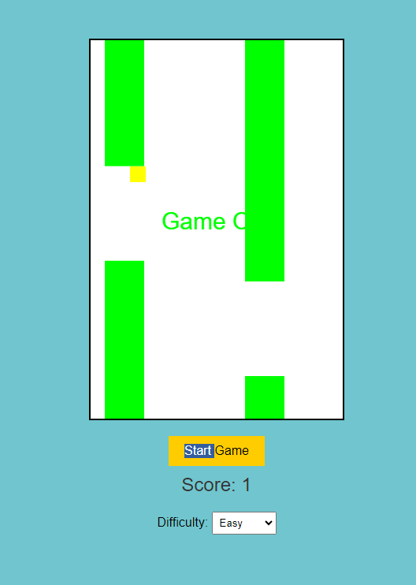
SAMPLE:

Slide 9
ENVIROMENT PREPARATION
Check Python version.
  python --version
Create Virtual enviroment in the file
python –m venv venv

Slide 10
The prompts:
Promt 1.
  lets create the flappy bird game with backend.py holding the game now a html and css file that will be used for display using Java script for Control. Make sure the code works perfectly.
Promt 2.
  now lets improve the game WE HAVE CREATED so we can click anywhere on the screen for control, and a counter for points. and also a section for settings to increase hardness level.

Slide 11
ASSIGNMENT.
Create a game like Ping Pong, or Guess the Number.
  If using python for display/GUI use this libraries: [pyqt5 · tkinter · pygui · kivy · wxpython · pysimplegui · libavg · pyforms etc] or use JAVASCRIPT NODE.Js or html and css the one your comfortable with
  [more instructions on how to submit your work in google classroom]

Slide 12
END
END

